Slide 1
Chapter 2 리눅스 커널 전체 구조
4 January, 2021
YE JIN HAN
hbb97225@naver.com

Slide 2
Sources / References
리눅스 커널 내부구조 by 최종무, 백승재
Linux Kernel Architecture by Wolfgang Mauerer
리눅스 커널 심층 분석 by 로버트 러브

Slide 3
Contents
Kernel: Concepts
Linux Kernel Architecture
Components of Linux Kernel
Summary
Q & A

Slide 4

Kernel : Concepts
What is Kernel?
A central part of OS that always lives in memory. (OS=Kernel + Other system programs)
What tasks does Kernel do?
resource manager: shares available resources (CPU time, memory, disk space …)
between the various system processes
Two implementation strategies of Kernel
Microkernels
Monolithic Kernels (with module) : Linux
Notes:
커널은 각 장치들을 관리하고 제어하기 위한 소프트웨어로, 컴퓨터가 부팅되면서 GRUB과 같은 부트로더에 의해 메모리에 로드되어 컴퓨터가 꺼질 때까지 항상 메모리에 상주하면서 각 장치들을 관리하고 제어하면서 사용자들과 의사소통을 지속적으로 함.ㅠㅐ

Slide 5
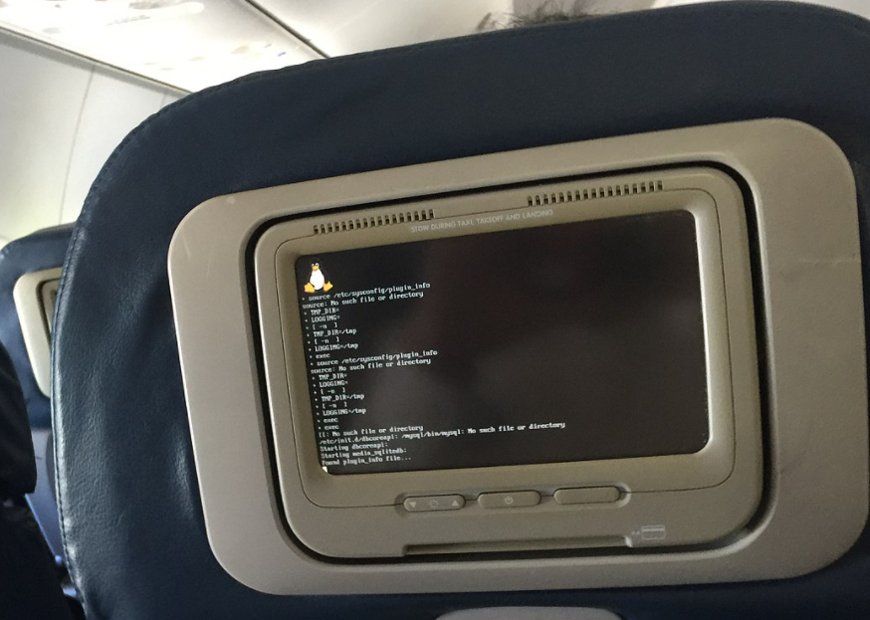
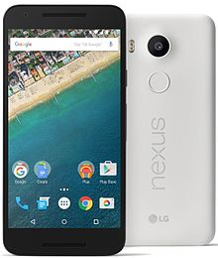
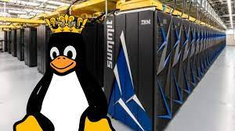

Kernel : Concepts
Why do we study Kernel?
Linux Kernel is now installed on millions of systems; countless ways from miniature embedded systems to massively parallel mainframes
Linux Kernel is sound, well-established software and still evolving today
Kernel developers have the highest annual salary in Silicon Valley
…
Notes:
커널은 각 장치들을 관리하고 제어하기 위한 소프트웨어로, 컴퓨터가 부팅되면서 GRUB과 같은 부트로더에 의해 메모리에 로드되어 컴퓨터가 꺼질 때까지 항상 메모리에 상주하면서 각 장치들을 관리하고 제어하면서 사용자들과 의사소통을 지속적으로 함.ㅠㅐ

Slide 6



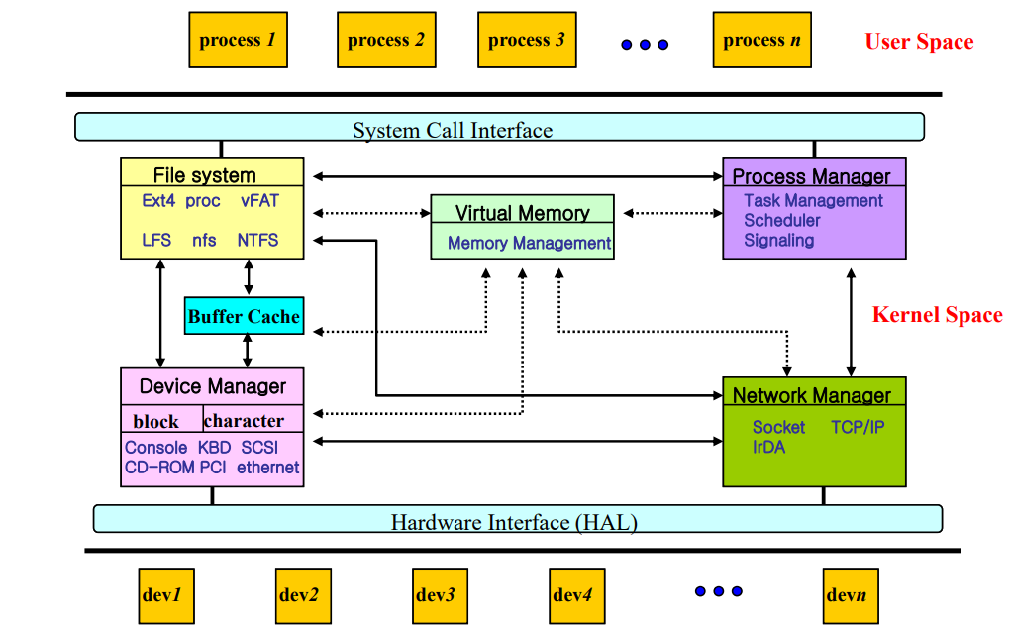
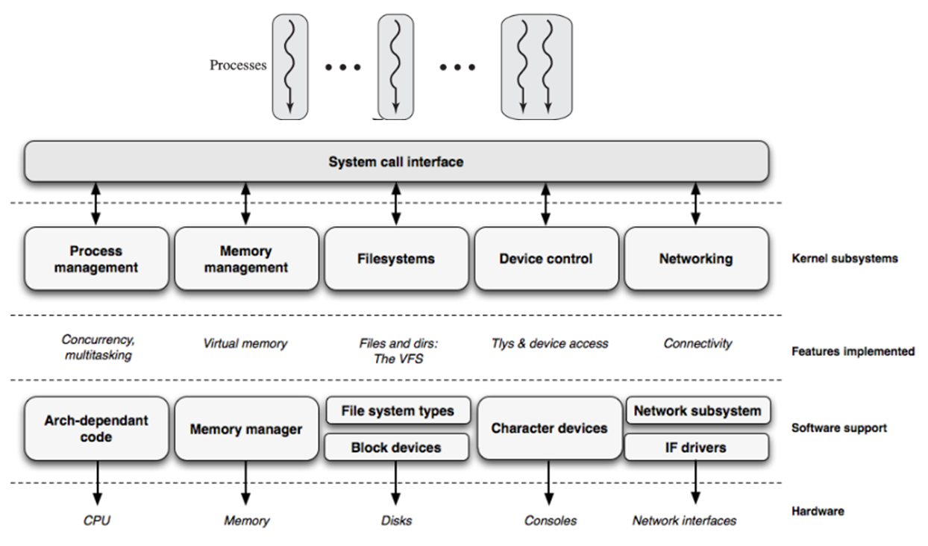
Linux kernel architecture
OS is resource manager
abstract physical HW resources into logical ones for providing services to users

Slide 7
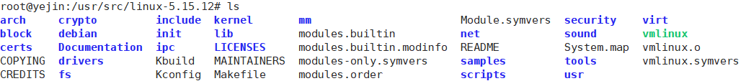
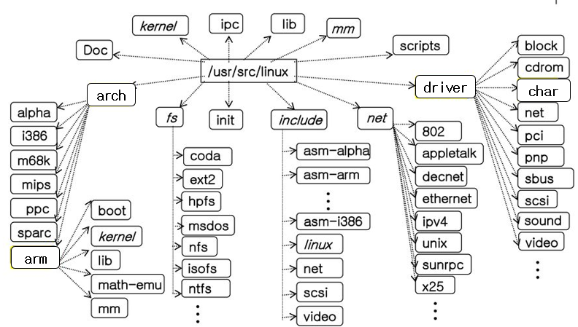
Linux kernel source-level architecture
…
/usr/src/linux-5.15.12
(https://elixir.bootlin.com/linux/v5.15.12/source)

Slide 8
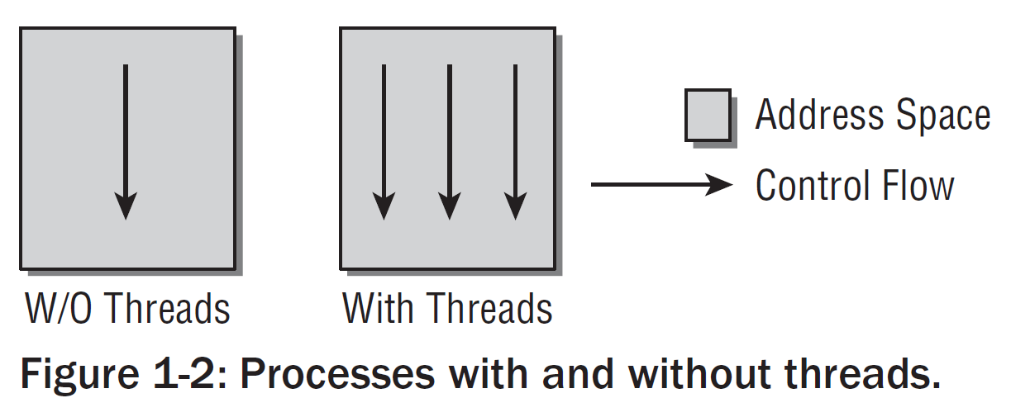
Components of Linux Kernel
Processes, task switching, scheduling
Running programs are referred to as processes.
Kernel switches the process by saving all state of the process and later saved state is restored, giving the illusion that CPU is always available
Kernel decide which process runs for how long by scheduling
Process and Threads
Process: executing program
Thread: a program function or routine
running parallel to the program

Slide 9
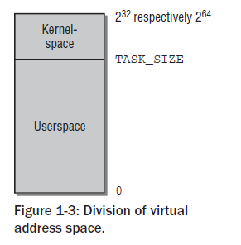
Components of Linux Kernel
Address space
The word length of the CPU determines the maximum
size of the address space (32-bit system → 4GiB)
Every user process has its own virtual address space
Linux divides virtual address space into two parts
as kernel space and userspace
Privilege levels
protect the individual system processes from each other
The switch from user to kernel mode is mad by system calls

Slide 10
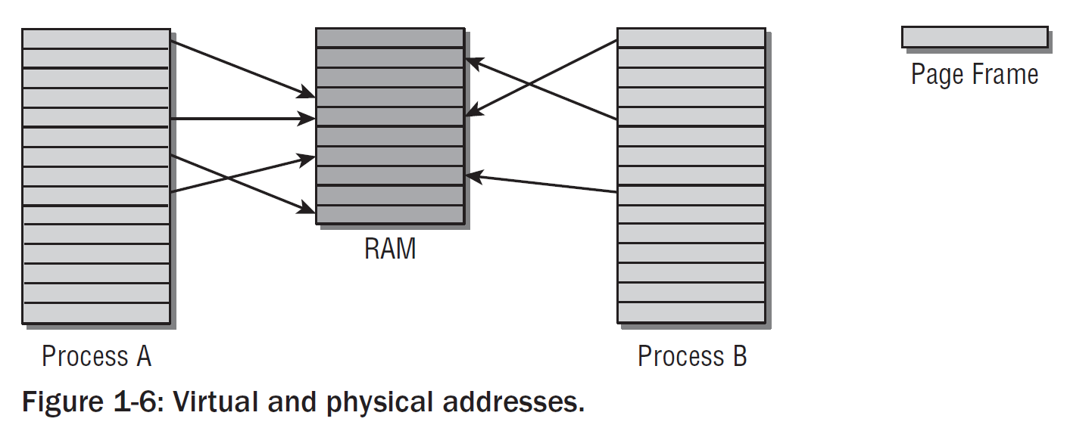
Components of Linux Kernel
Virtual and Physical Address Spaces
Kernel consider how the physical memory can be mapped onto VAs
The Virtual address spaces are divided into equal size as pages
Physical memory is also divided into the same size as page frame

Slide 11
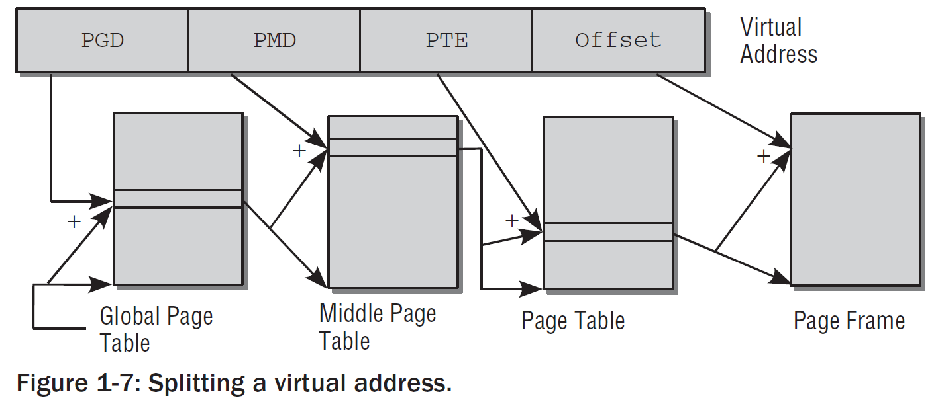
Components of Linux Kernel
Page tables
Page tables recode where each page is placed in physical frame
Multilevel paging is used to reduce the size of page tables and to allow unneeded areas to be ignored
TLB is the way to speed up the translation

Slide 12
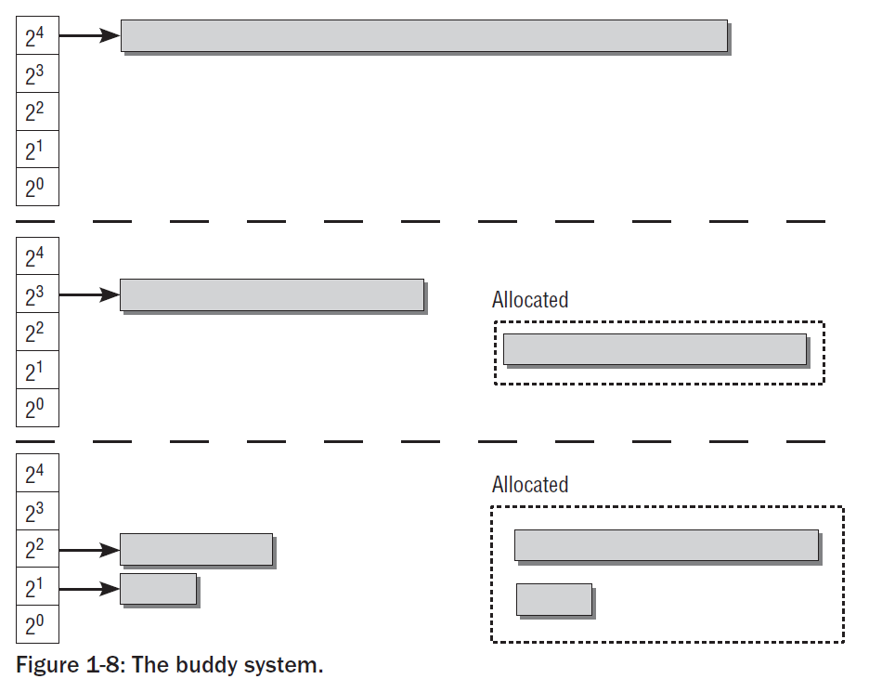
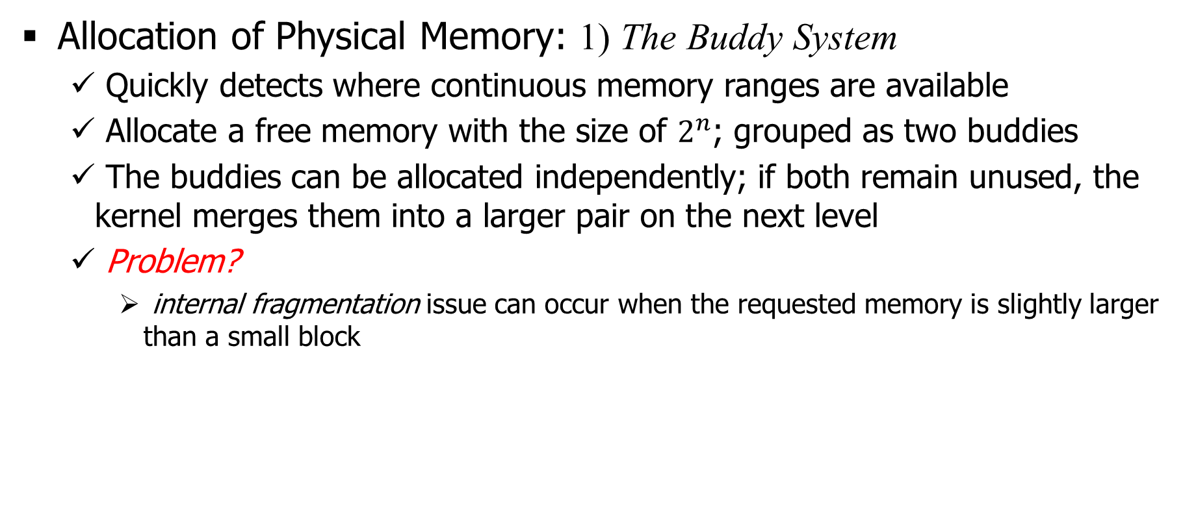
Components of Linux Kernel
Allocation of Physical Memory: 1) The Buddy System
Quickly detects where continuous memory ranges are available
Allocate a free memory with the size of $2^{n}$; grouped as two buddies
The buddies can be allocated independently; if both remain unused, the kernel merges them into a larger pair on the next level
Problem?
internal fragmentation issue can occur when the requested memory is slightly larger than a small block

Slide 13
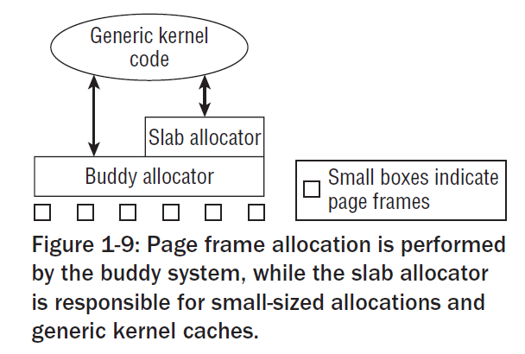
Components of Linux Kernel
Allocation of Physical Memory: 2) The Slab Cache
To provide the memory blocks smaller than a whole page frame
divides the memory blocks into smaller portions in advance
For frequently used objects, the kernel defines its own slab cache

Slide 14
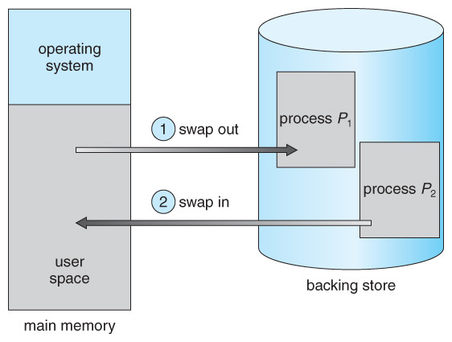
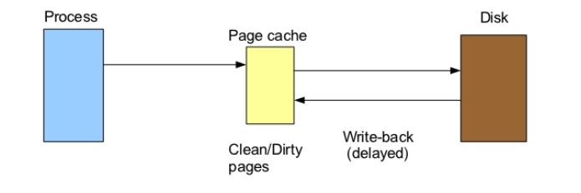
Components of Linux Kernel
Allocation of Physical Memory: 3) Swapping and Page Reclaim
By Swapping, infrequently used pages are written to disk when available memory space is insufficient
Once data are actually needed, the kernel swaps them back into memory
Page reclaim is used to synchronize modified mapping with block devices

Slide 15
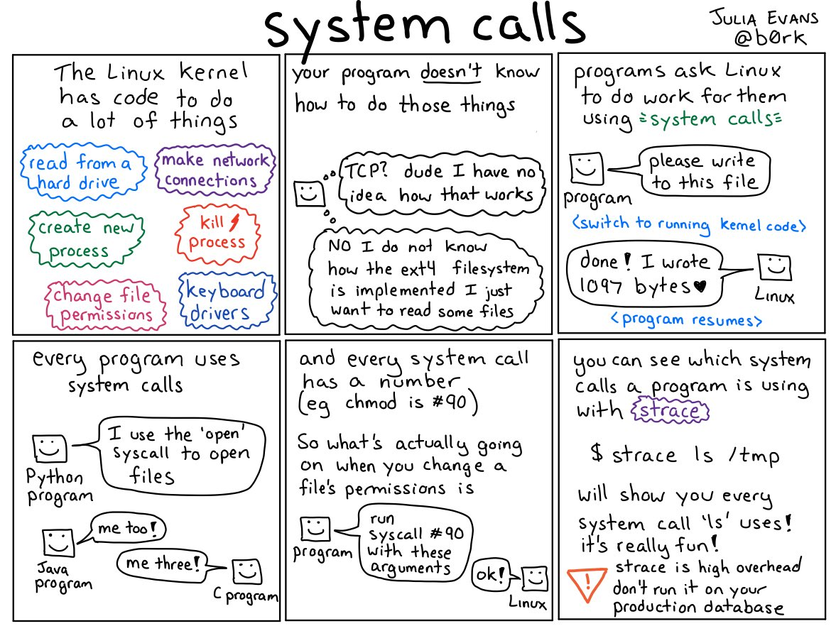
Components of Linux Kernel
System Calls
The method of enabling user processes to interact with the kernel
Process Management
Signals
Files
Directories and Filesystem
Protection Mechanisms
Timer Functions

Slide 16


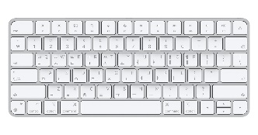
Components of Linux Kernel
Device Drivers
Device Drivers: support application communication with I/O devices
To enable data to be read from and written to a device in a suitable way
Peripheral devices
Block Device
Data can be randomly accessed and to freely select the position to read data
Devices allow data to be read/write in multiples of block units
Character Device
Deliver a continuous stream of data that applications read sequentially
Devices allow data to be read/write byte-by-byte or charter-by-character

Slide 17
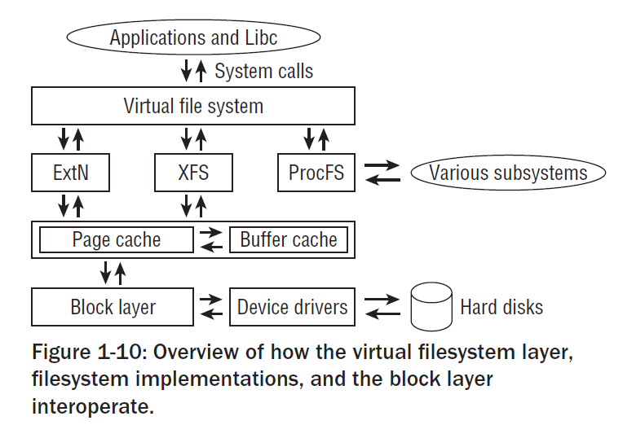
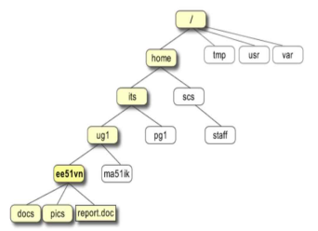
Components of Linux Kernel
Filesystems
When storing files on block devices, hierarchical filesystems are used
allow stored data to be organized into directory structures
have the job of linking other meta-information with the actual data
VFS(Virtual filesystem) is needed to abstract the various filesystems

Slide 18
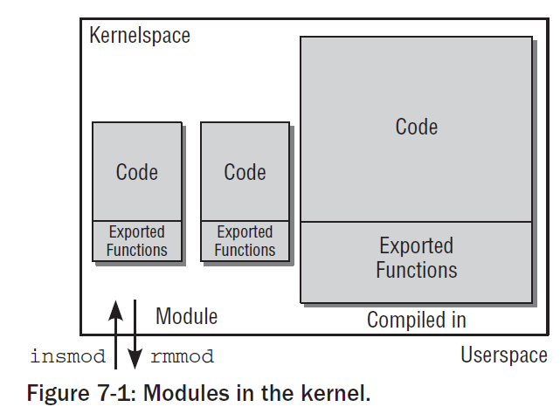
Components of Linux Kernel
Modules and Hotplugging
Modules are an efficient way of dynamically adding functionality (device drivers, filesystem, and other components…)
Can compensate for the disadvantages of monolithic kernels
Modules are an essential requisite to support for hotplugging

Slide 19
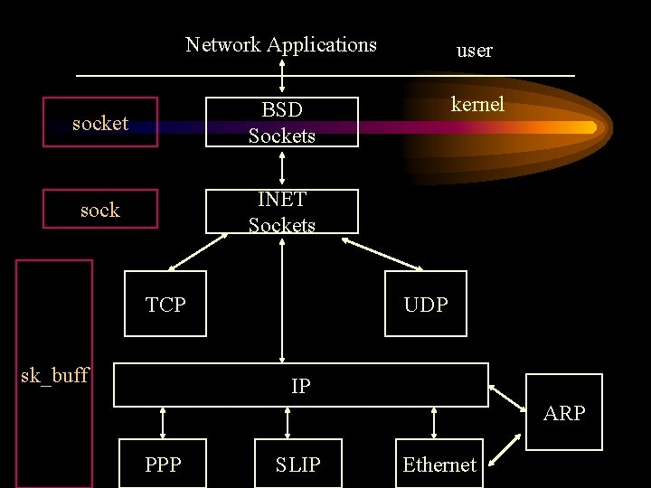
Components of Linux Kernel
Networks
During network communication, data are packed into protocol layers
When data received, the Kernel disassemble and analyze the layer before the data are passed to application
To support work with network connections via the file interface, Linux uses sockets from the BSD world

Slide 20
Issues of Linux Kernel
Debugging the kernel is usually harder than userland programs
Kernel errors will take the shole system down; or even worse
Kernel code must work both on machines with little/big endian

Slide 21
Summary
The Linux kernel is one of the most interesting and fascinating pieces of software.
Kernel is a central part of OS and it has various components
We will take a closer look at the source code from now on

Slide 22

Q & A

